Slide 1
Working with Git Bash
JSC270 Lab 4

Slide 2
Acknowledgment
Thanks to Matthew Edwards, TA for JSC270 in 2021, for the original version of these slides!
1/37

Slide 3
Last Week: Git
Recall last week, we learned about version control
•
Git is a version control system used to track changes in sets of ﬁles (called repositories, or repos )
•
It was originally designed for computer programmers to collaborate during software development
•
Today, almost all data science teams (in both academia and industry) use it to track their work
•
The system includes a small (but very powerful) set of commands for editing and tracking ﬁles, including:
•
push
•
add
•
clone
•
pull
•
commit
•
branch
2/37
Notes:
This a recap of last week: they received an intro to basic git and github and also forked a repo and edited a google colab within that repo. The goal of this week is to reiterate the key ideas to them and introduce git bash.
If you’re interested you can see more last week here: https://github.com/jlgrons/JSC270_Lab3
As you go through, you can show the commands in your own command line

Slide 4
Last Week: GitHub
If the goal is collaboration, these ﬁle collections (aka repos) should be stored somewhere easily accessible
•
GitHub is an internet hosting service designed to store Git repositories. It allows for easy interaction with Git
•
It is not the only service that does this (e.g. GitLab, BitBucket, SorceForge), but it is by far the most popular and free it is free!
•
Git and GitHub can track multiple branches (or versions) of the same repository, so contributors can make changes in parallel without aﬀecting the main/master branch
•
This is particularly useful if you’re experimenting (ie. you’re not sure if your changes will actually work)
3/37

Slide 5
A Basic Git Workﬂow
Here is a basic step-by-step process for managing repos:
1. You have a new repo you’d like to work with. Either you’ve created it yourself, or it is someone else’s public repository.
•
Recall from last week: Only you (the repo creator) and contributors you allow can see a private repo.
2. You Fork or Clone that repo to your local machine (e.g into your local gitrepos folder). More on this later.
3. You edit ﬁles in the local repo (or create new ones). If you’re experimenting, you would ﬁrst create a new branch, so your changes do not aﬀect main.
4/37

Slide 6
A Basic Git Workﬂow
4. You submit any changes you’ve made so they can be tracked by Git. This is a two-part process:
i) Use the add command to move changes to the staging area. This tells Git that you have changes to be included in your next commit.
ii) Use the commit command to save these changes to your local repo. This eﬀectively takes a ’snapshot’ of your ﬁles.
Note:
Committed snapshots are safe - Git will never change them unless you tell it to.
Every commit you make is recorded and tracked, so you may revert back to past versions of your project at any time.
5/37

Slide 7
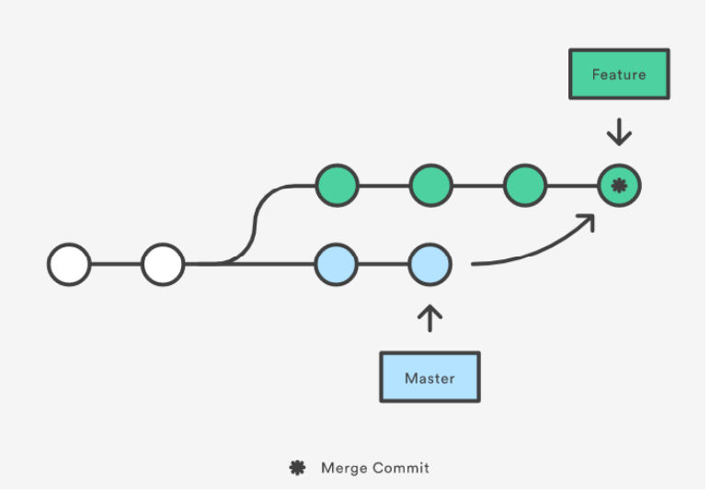
A Basic Git Workﬂow
5. (Optional) If you were experimenting on a diﬀerent branch, you can merge your newer version back into the main branch.
6. You use the push command to push your commit(s) from your local repo to the remote repo (on GitHub). Again, more on this later.
Source: https://www.atlassian.com/git/tutorials/merging-vs-rebasing
6/37

Slide 8
A Basic Git Workﬂow
7. If other contributors are following a similar process, it’s likely they will push changes to the remote (GitHub) repo that you do not have locally. Use the pull command to to update your local repository to the most current version.
Note:
In this course, you will be the only ones editing your assignment ﬁles (although we need contributor access to read them), so steps 5 and 7 may not be necessary.
But in practice, there could be many contributors, and the remote repo might be ahead of (upstream from) your local version. So a good rule is to always pull before you make changes.
7/37

Slide 9
Question Time
Any questions about Git or GitHub (or about anything else so far)?
8/37

Slide 10
What is Bash?
So what does any of this have to do with Bash?
•
A command line interface (CLI) is an interpreter that processes text commands to allow interaction with your computer’s operating system.
•
The Born-again Shell, or Bash, invented in 1989, is one of the most popular CLIs available
Bash is designed to work seamlessly with Git, but also makes it very easy to navigate through the ﬁles on your computer
•
•
Every step in the workﬂow above can be done in Bash
9/37

Slide 11
Installing Bash (from last week!)
Mac Users: Good News! Apple computers use a version of Bash as the default CLI.
•
To open the shell, simply use Command + Spacebar to launch Spotlight, then search Terminal and double-click the search result
•
Alternatively you could click through Applications -> Utilities and ﬁnd Terminal in there
10/37
Notes:
the students should have already downloaded BASH - they received the instructions last week, but I am placing them here just in case

Slide 12
Installing Bash (from last week!)
Windows Users: Unfortunately Bash is not the default, so we’ll have to install it separately
1. Go to the install page: https://gitforwindows.org/
2. Click the ’Download’ button
3. Once downloaded, run the .exe ﬁle
4. "Do you want to allow this app to make changes to your device" -> Yes
5. Use the default settings. Keep clicking Yes, and then eventually, click Finish
11/37
Notes:
https://gitforwindows.org/

Slide 13
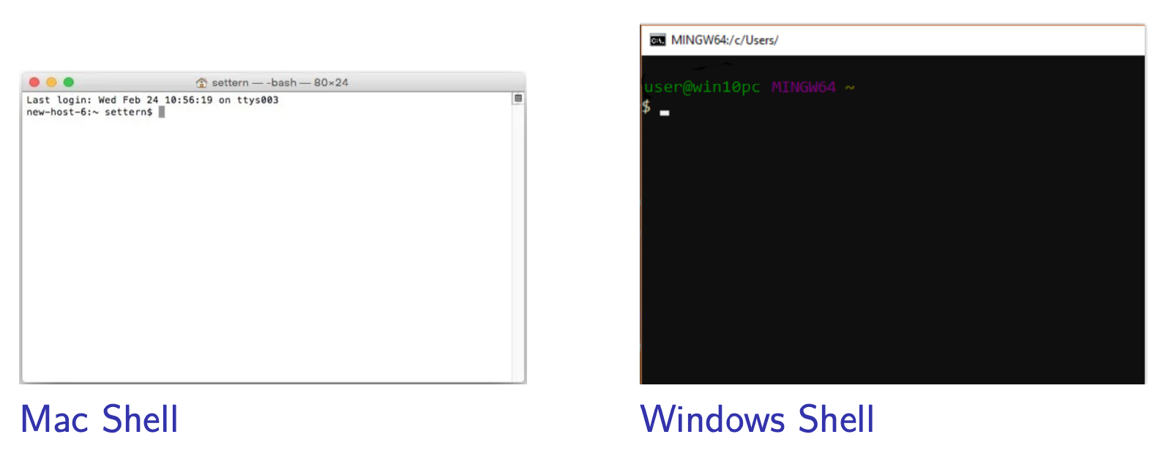
The Shell
For Windows, the application is called Git Bash.
•
You can open this by searching ’Git Bash’ in the Windows Start menu
12/37

Slide 14
Exercise 1
•
Windows users, go ahead and install Git Bash using the instructions above, if you haven’t already. Then open the Bash shell
•
Mac Users can just open the terminal. You can type “terminal” into the spotlight search to open up terminal.
13/37

Slide 15
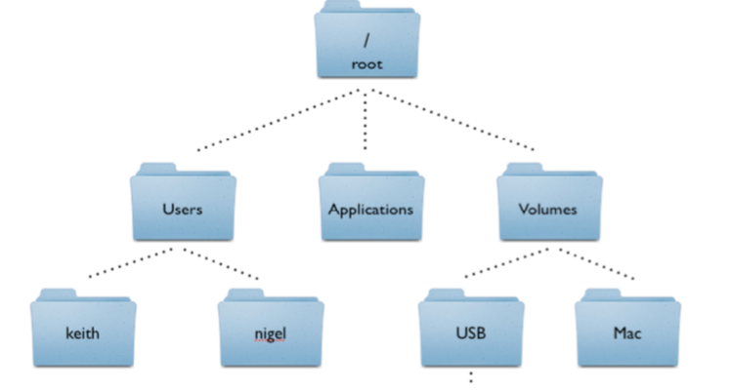
Navigating Your File System
•
Your computer stores ﬁles in a tree structure
*When you open a new bash shell, you are automatically at the root of your ﬁle tree
•
The top of the tree is called the root
•
Individual ﬁles are grouped together in folders, known as directories
•
Some directories can be made into git repos
Source: http://korflab. ucdavis.edu/Unix_and_ Perl/unix_and_perl_v3.0. html
14/37

Slide 16
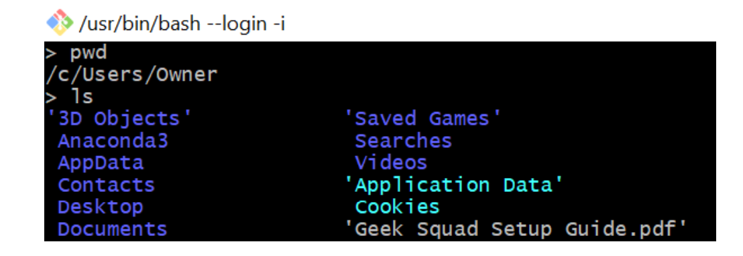
Navigating Your File System
The bash shell (Windows or Mac) will indicate that it is ready to receive your commands by prompting you with a $
•
To identify where your shell is looking in your ﬁle tree, you can use the pwd command (print working directory) to print your location. Try it yourself (type the command in, and press enter)
•
Use the ls command to ’list’ all the ﬁles in your current directory (this may include other directories)
15/37

Slide 17
Navigating Your File System
Suppose we want to move further down our ﬁle tree:
•
We just used ls to identify subdirectories (folders) within our current directory.
•
To move into one of these subfolders, type:
cd <dir name> (which directory you choose is up to you) This command stands for ’change directory’
•
You have now moved into the subdirectory, and can view the contents of this new folder with the ls command (see for yourself!)
16/37

Slide 18
Some Other Useful Navigation Tricks
Question: What if we want to go up the ﬁle tree instead of down?
Answer: Bash uses the argument ../ to mean ’the parent directory of my current location’
•
So by typing:
cd ../
I move up one level of the tree.
•
Note that cd also accepts longer ﬁle paths so by typing:
cd ../../../
I would move up three levels (assuming you are at least 3 levels down)
17/37

Slide 19
Some Other Useful Navigation Tricks
After a few commands in a row, you’ll probably be close to the bottom of the shell:
•
Use the clear command to remove the history shown in the shell (Bash still maintains your current directory, which you can conﬁrm using pwd or ls)
•
When moving down several directories at once, you can use the TAB key to autocomplete directory names as you type (this assumes the name is unique):
cd Documents/gitrepos/JSC270.github.io/
18/37

Slide 20
Question Time
Any questions about ﬁle navigation?
20/37

Slide 21
Creating, Removing, and Renaming Directories
We can do more than look at our ﬁle tree: we can add new directories
•
We use the command mkdir <newdir name> to create a new directory (here, <newdir name> is something you choose)
•
The command rmdir <dir name> will remove an existing directory
•
You can use mv <oldname> <newname> to rename a directory. This command stands for ’move’, since you can also use it to move a directory
21/37

Slide 22
Forking or Cloning Existing Repos
•
When you clone a remote repository, you’re just making a copy of that repo on your local machine
•
Anyone can clone any public GitHub repo
•
However, if you’re not a contributor on the repo you cloned: 1. You cannot push local changes you make back to the remote (GitHub) repo
2. You cannot pull new changes made by the contributors to update your local version (you would have to re-clone that remote repo if you wanted to update)
•
The command to clone a repo is:
git clone http://github.com/username/repo-name where username and repo-name depend on the repo
23/37

Slide 23
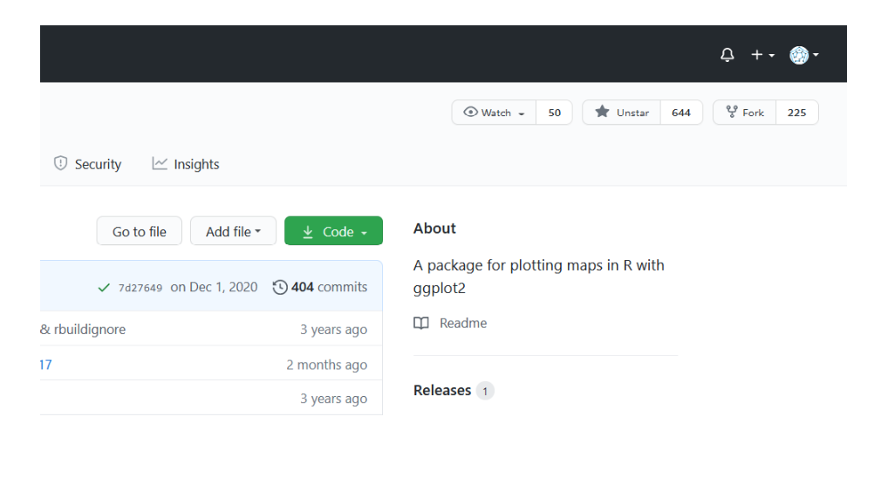
Forking or Cloning Existing Repos
If you want to add to a GitHub repo but aren’t the creator/contributor, you ﬁrst need to fork that repo.
•
Forking creates a copy of the repo you want on your account. Your copy is connected to the original repo, but changes you push to your forked copy do not aﬀect the original
24/37
Notes:
They forked a repo last week so they should be familiar with cloning vs forking

Slide 24
Forking or Cloning Existing Repos
•
You can fork a repo using the “fork” button in the upper right corner on the GitHub repo page (see previous slide)
•
Then you would clone your forked copy to your local machine (as before)
•
To actually change the original repo, you would:
1. Make changes locally, and push them to your forked copy (usually on a separate branch)
2. Submit a pull request to the original repo owner, so they can merge the changes on your fork into the original remote repo
25/37

Slide 25
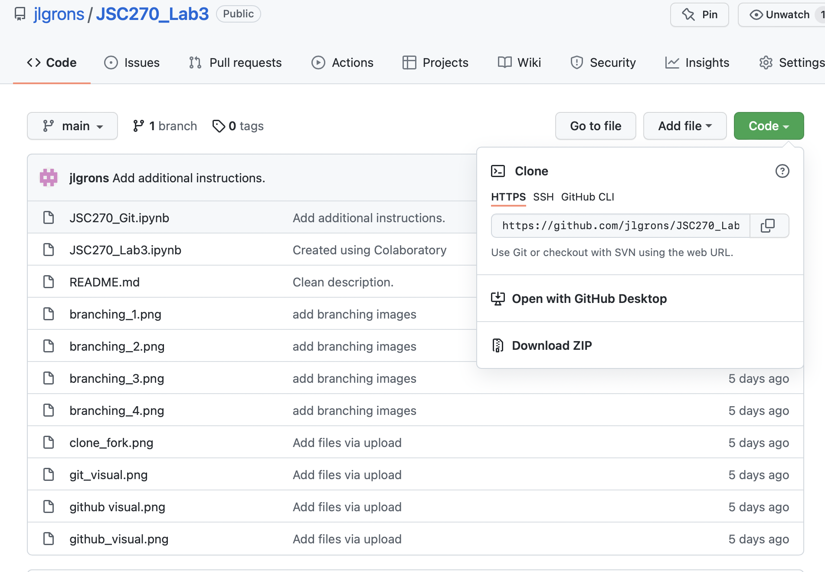
Exercise 3: Cloning Your Repo
Let’s make a new repo and clone it:
1. You can copy the link to your remote repository using the green button on GitHub
27/37
Notes:
https://github.com/jlgrons/JSC270_Lab3: Repo link in case they havent forked it (from last week)
Make sure to clone the forked repo (not the original) the picture is just to show them where the get the link to clone
Also make sure to change the directory to the repo after the do this so changes are made there: cd JSC270_Lab3

Slide 26
Exercise 3: Cloning Your Repo
2. Make sure you’re actually in your gitrepos directory (use the cd command if you’re in its parent directory)
3. Clone your remote repo to your local machine by typing:
git clone <repo weblink>
4. Change the directory to the cloned repo
28/37

Slide 27
Creating Files
In addition to creating directories, we can also create ﬁles:
•
Use the command
touch <filename>
to initialize a ﬁle (e.g. touch example.txt)
•
Then use
start <filename> or open <filename>
to open and edit that ﬁle
•
We can use a similar syntax to open an application without specifying a ﬁle name:
e.g. start firefox
•
To remove a ﬁle use:
rm <filename>
29/37
Notes:
Just a note, on my mac, I have to use ‘open’ instead of the start command - i think it is only open on apple, and start on windows
eg
touch example.txt
open example.txt

Slide 28
Question Time
Any Questions?
30/37

Slide 29
Exercise 4: Adding a Text File to Your Repo
Using the touch and start commands, create a ﬁle in your assignment 2 repo called prereq.txt
•
In this text ﬁle, please indicate all the diﬀerent types of statistical distributions you’re familiar with (ie the ones you’ve worked with before)
•
You can separate them with commas, or put one distribution on each line (the exact formatting doesn’t matter)
•
The next page contains a list of distributions for you to reference
31/37

Slide 30
Exercise 4: Adding a Text File to Your Repo
Some types of distributions:
•
Uniform
•
Poisson
•
Negative
•
Normal
•
Chi-squared
Binomial
•
Bernoulli
•
Student-T
•
Cauchy
•
Binomial
•
F Distribution
•
Laplace
•
Exponential
•
Gamma
•
Pareto
•
Geometric
•
Beta
•
Rayleigh
•
Hypergeometric
•
Multinomial
•
Weibull
32/37

Slide 31
Tracking and Committing Changes
Once you’ve modiﬁed existing ﬁles or created new ones in your local git repo, we can use the process from last week to commit those changes:
1. Make sure you’re in your git repo (use the cd command if not)
2. Use git status to check for modiﬁcations to the local repo
3. Use git add <filename> or git add . to stage your revisions
4. Use git commit -m “Message” to commit the changes (take a snapshot)
5. Push the newest commit to the remote repo with git push
33/37

Slide 32
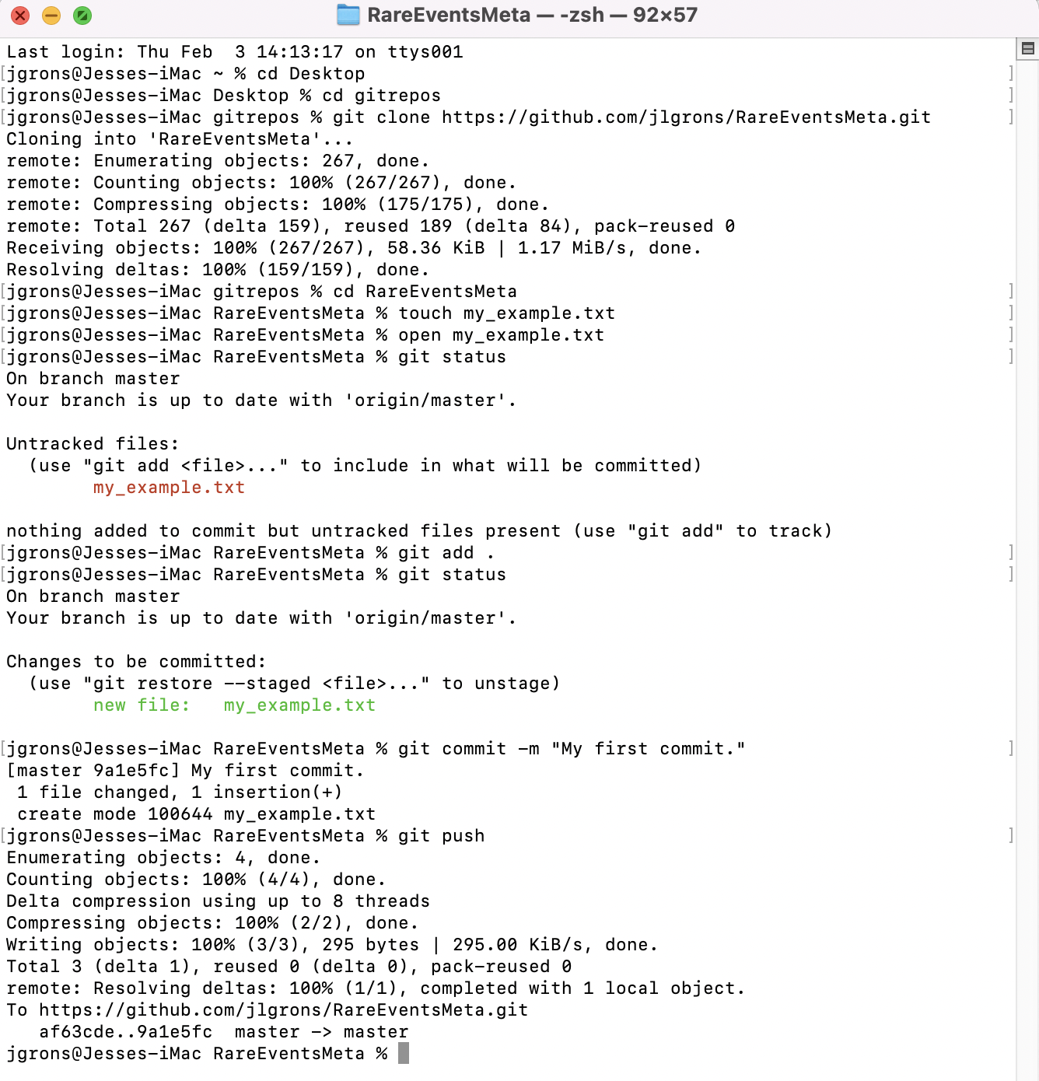
Exercise 5: Committing Your New File
Go ahead and follow the steps above to add, commit, and push prereq.txt to your remote repository for Lab 3
Example: Cloning ‘RareEventsMeta’ forked repo and adding and opening example.txt.
34/37

Slide 33
Exercise 5: Committing Your New File
You’ll notice Bash uses diﬀerent colours to separate modiﬁcations that haven’t been staged (red) from those that are staged but not committed (green)
35/37

Slide 34
Exercise 5: Committing Your New File
You’ll know you’ve succeeded when you get a message similar to:
36/37

Slide 35
Conclusion
In terms of Bash’s capabilities, this is just the tip of the iceberg. You can:
•
Customize the look of the shell
•
Run programming ﬁles directly from the command line
•
Alias certain commands (ie customize the shell commands to your liking)
•
An alternative to using Bash is the GitHub Desktop App
But, we’ve covered everything you’ll need for JSC 270. Questions?
37/37

